Slide 1
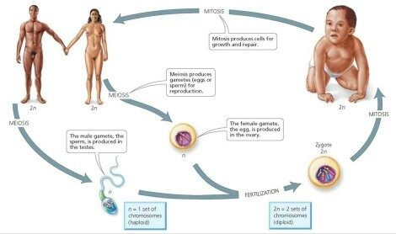
Meiosis vs. Mitosis
Chapter 11.4 (p.324-329)

Slide 2
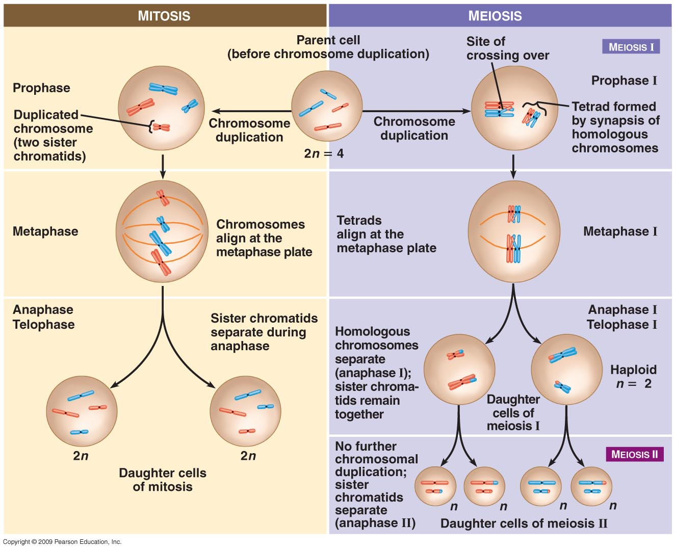

Slide 3
 | Mitosis | Meiosis
Function
Type of Organisms That Carry Out Process
Location in Body
Crossing Over?
Sister Chromatids Separate
Change in Chromosome Number
Daughter cells haploid or diploid
Number of Daughter cells Produced
Number of Cell Divisions
Genetic Makeup of Daughter Cells Compared to Parent Cell

